Slide 1
Report to the
Tarrant County Commissioners Court
and the JPS Board of Managers
February 27, 2018
Notes:
This meeting is being video-recorded.
Video file will be uploaded to Tarrant County website.

Slide 2
The Citizens Blue Ribbon Committee
was charged with evaluating the Tarrant County’s
future health care needs and delivery systems and the role that the JPS Health Network will play in this process.
Randy Moresi, Co-Chair
Stuart Flynn, MD
Elizabeth Treviño, PhD
Pastor Michael Evans, PhD.
Mark R. Berry
Steven L. Simmons, D.O.
JPS Liaisons
Dr. Roy Lowry, D.O.
Trent Petty
Lorraine C. Miller, Co-Chair
Dee J. Kelly Jr.
Tiesa R. Leggett
Howard Patterson Hezmall, M.D.
Scott W. Fisher
Sarah Hollenstein
TC Comm. Court Liaisons
Comm. Roy Charles Brooks
Comm. Andy Nguyen
2

Slide 3
JPS Health Network is an important asset
Tarrant County’s only Level 1 Trauma Center
Geriatric trauma program
More than 40 locations on or near its main campus as well as in the neighborhoods where patients live
13 community health centers, 19 school-based clinics and other specialty care clinics
3

Slide 4
JPS Health Network is an important asset
Served as the community’s public health care system for more than 100 years
The county’s only psychiatric emergency services
4

Slide 5
JPS Health Network is an important asset
A leading academic teaching hospital
Has a long history of training medical professionals
The nation’s largest hospital-based Family Medicine residency program
5

Slide 6
JPS Health Network is an important asset
Partners in education with:
UT Southwestern Medical School
Baylor Medical Center
UNT Health Science Center
Texas Christian University
Tarrant County College District
UT- Arlington
Tarleton State University
Texas Wesleyan University
6

Slide 7
Consultant reviewed national trends in health care, providing insight on their relevance to Tarrant County
Studied the current and future health needs
of county residents
Evaluated past demographic changes and made projections
Predicted a 20-year population growth of more than 1 million people
7
Notes:
Introduce HMA and Cumming and their roles
__________________________________________________________
__________________________________________________________
__________________________________________________________
__________________________________________________________

Slide 8
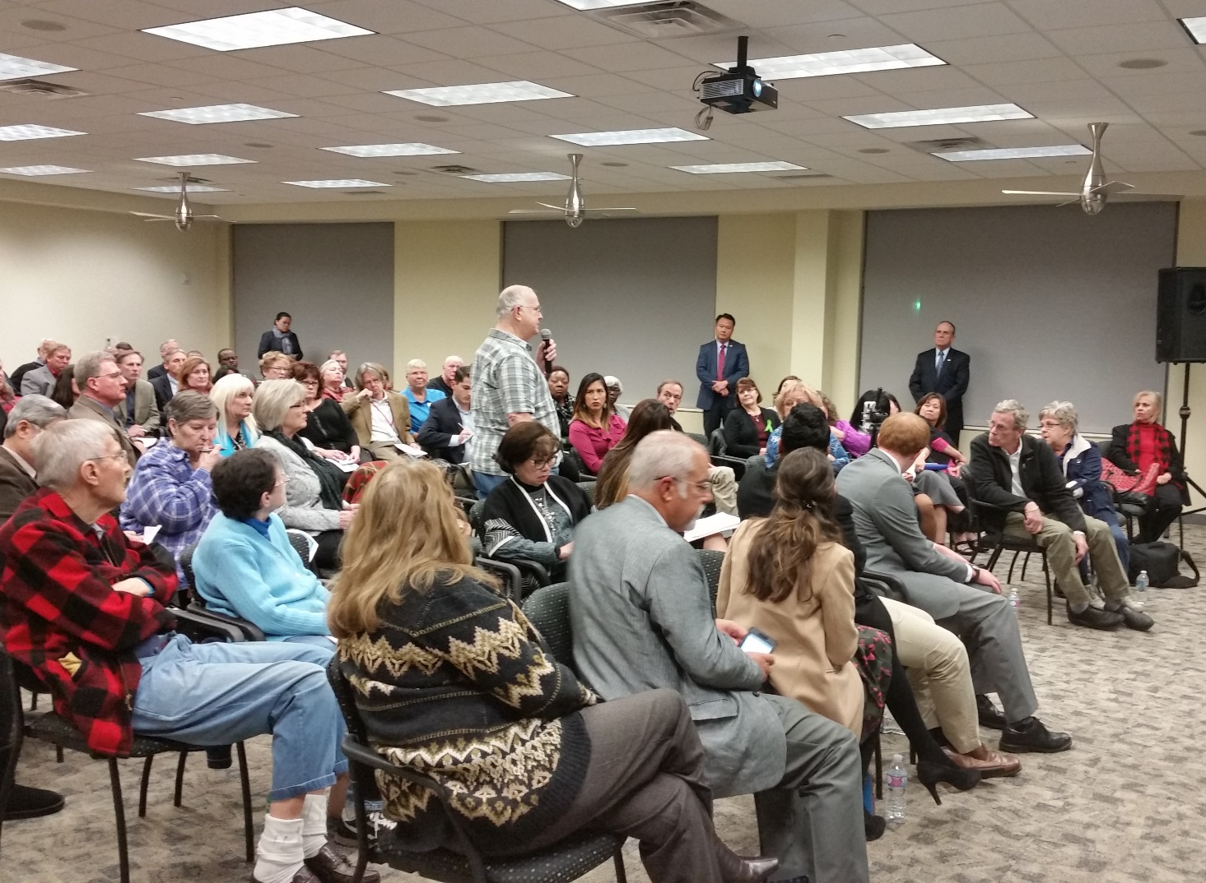
Stakeholder perception of JPS explored
Individual interviews
Focus groups
Community forums
8
Notes:
Introduce HMA and Cumming and their roles
__________________________________________________________
__________________________________________________________
__________________________________________________________
__________________________________________________________

Slide 9
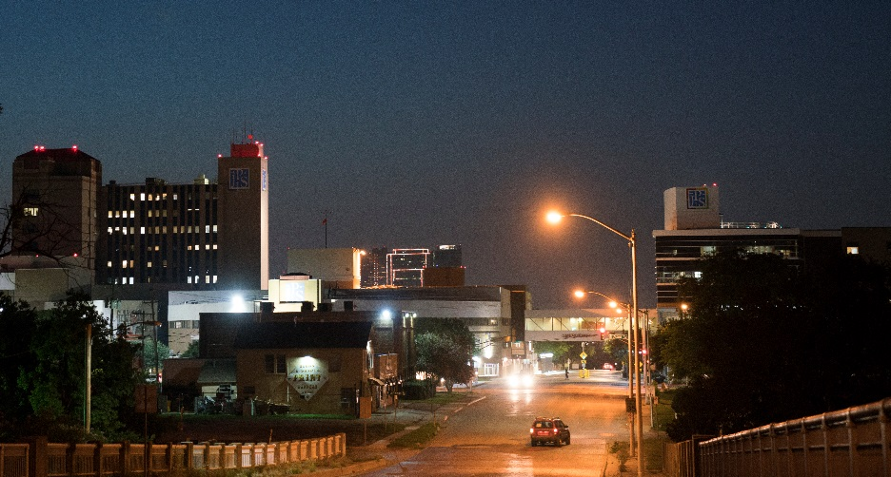
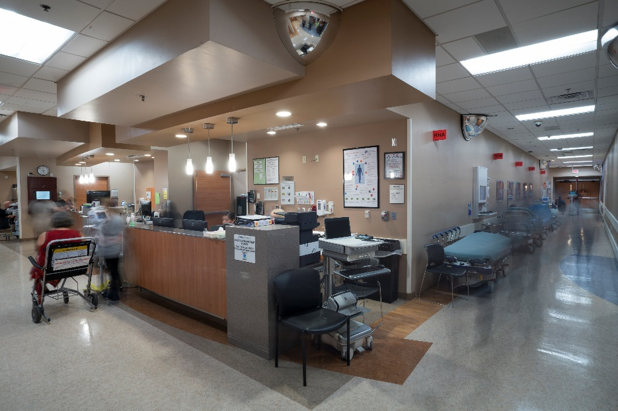
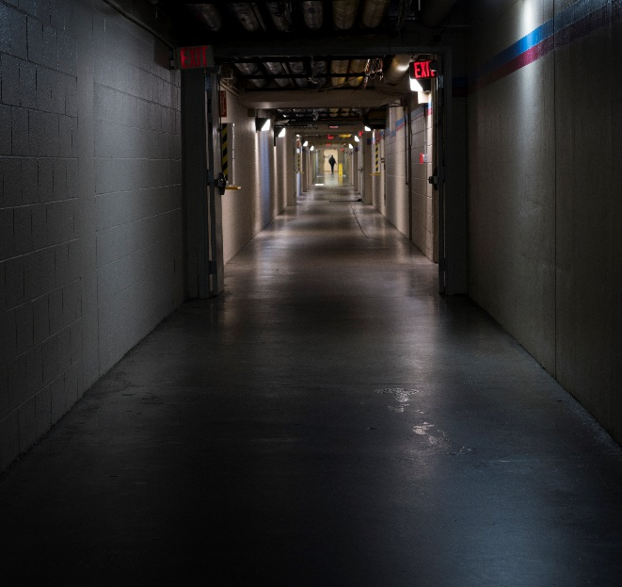
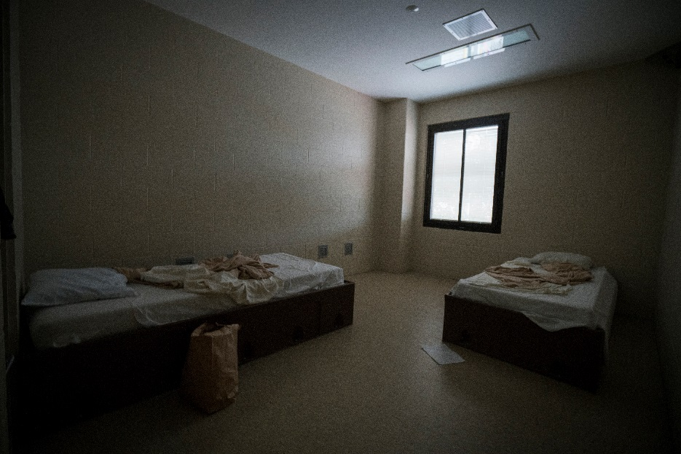
The current health care delivery system was assessed
Committee toured JPS facilities
A second consultant (Cummings)
assessed the current conditions
of these facilities
9

Slide 10
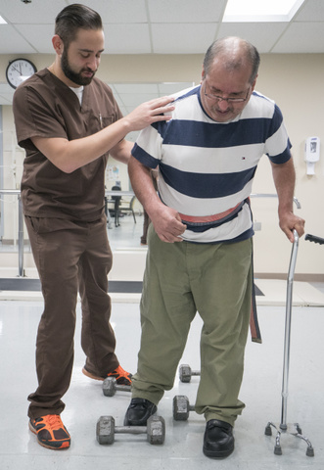
Rapid growth, aging and increased
diversity of the population affect
Health care
capacity
Facilities
Workforce
Types of
services offered
10

Slide 11
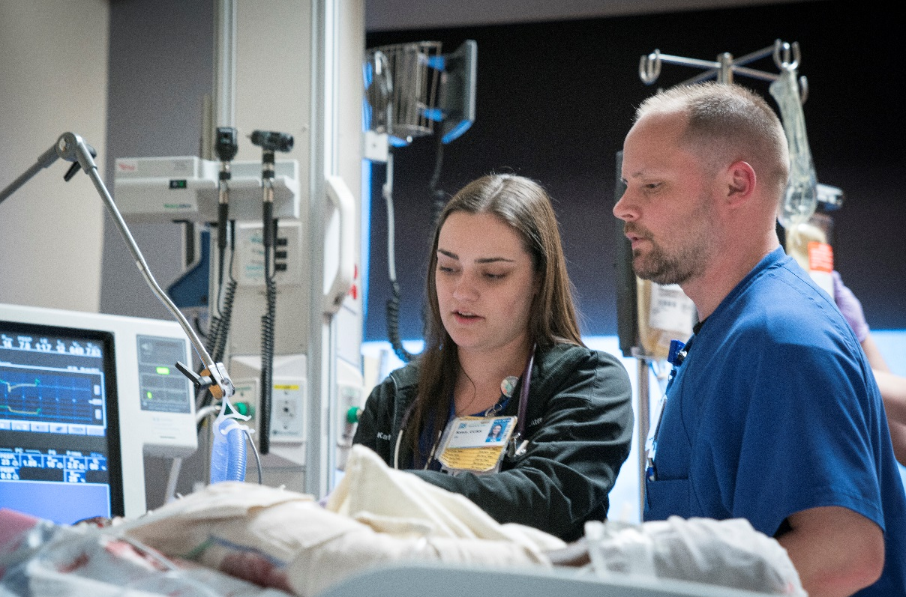
New approaches will be needed for:
Health care
Public health
Social services
New Pic
11

Slide 12
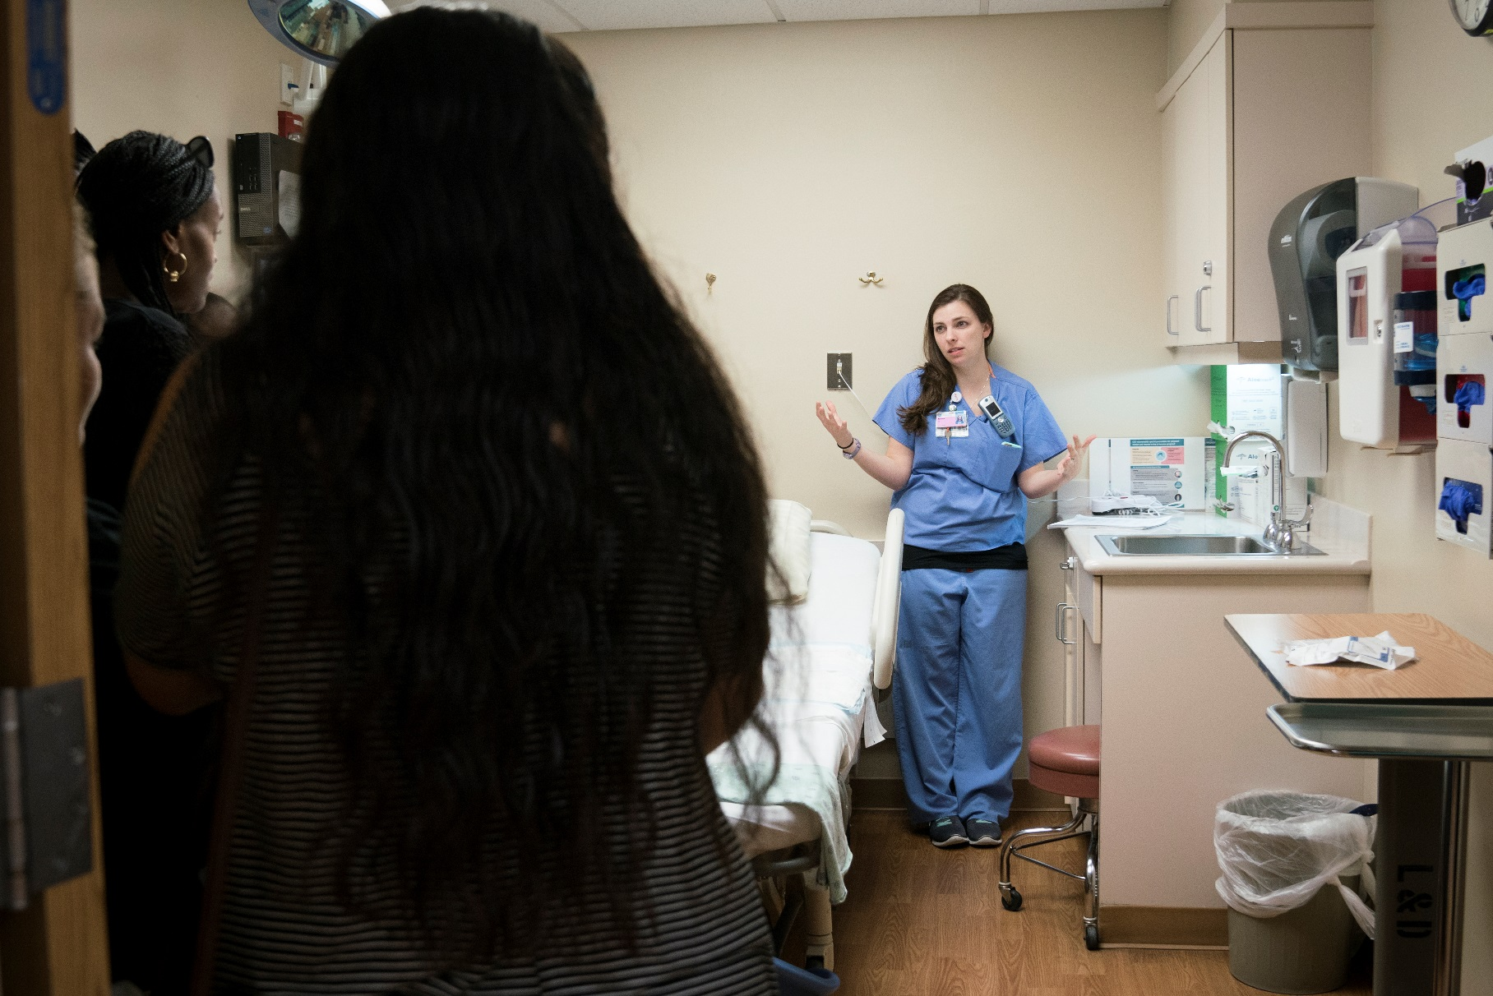
Tarrant County has a shortage of health professionals
12

Slide 13
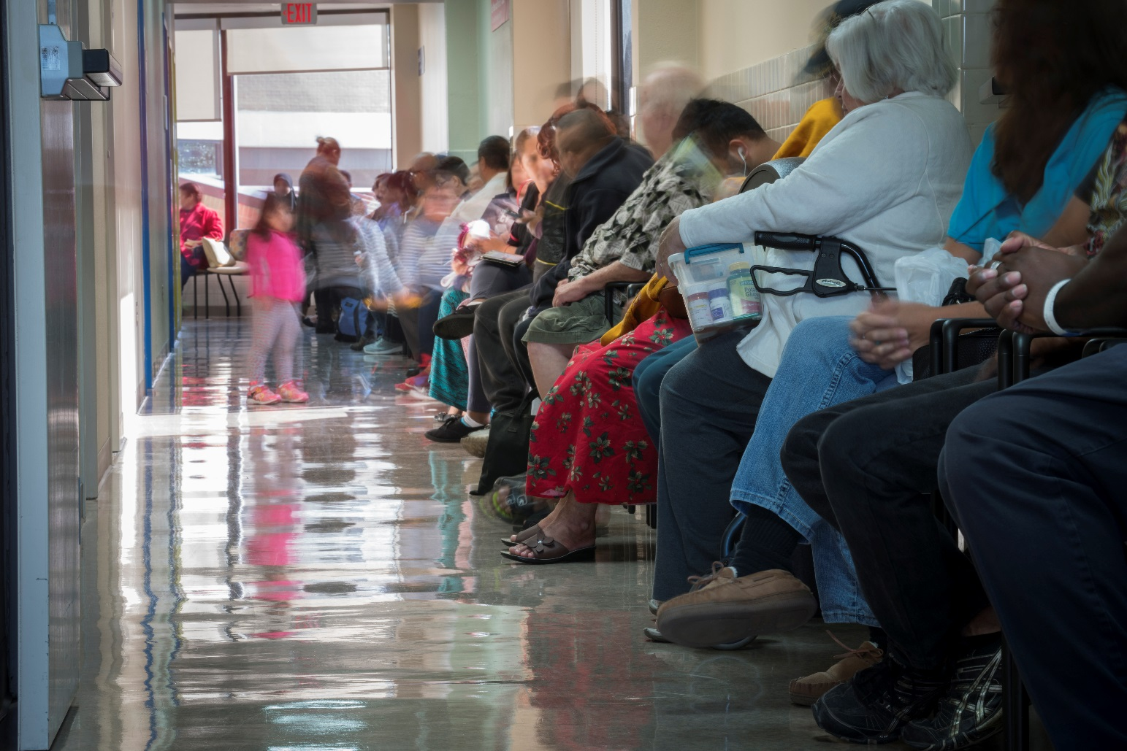
The JPS hospital main tower and behavioral health facility does not meet current demands or future needs
13

Slide 14
New community health care centers needed to:
Decrease the need
for preventable,
costly inpatient care
Shift the emphasis
from hospital care
to ambulatory care
Include behavioral
health services and,
if possible, oral health
services
14

Slide 15
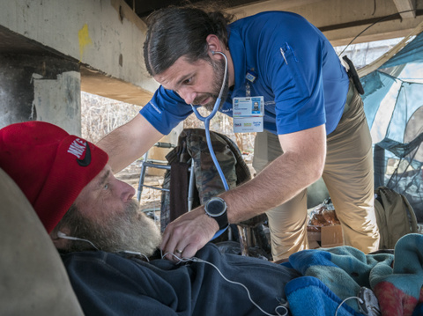
Identified opportunities to meet the needs of low-income uninsured and underinsured
15

Slide 16
The Citizens Blue Ribbon Committee
Strategic
Recommendations
16

Slide 17
The Citizens Blue Ribbon Committee
Strategic Recommendations
JPS urged to partner with other health care entities to:
Reduce preventable, duplicated and costly health care utilization
Improve health quality of life for low-income uninsured
and underinsured patients
Stimulate efforts concerning new and improved methods addressing the overall health of county residents.
17

Slide 18
The Citizens Blue Ribbon Committee
Strategic Recommendations
The committee also proposed that JPS:
Lead planning efforts to improve the countywide behavioral health system of care
Build and retain a health care workforce to meet anticipated population increases
Partner with Tarrant County Public Health,
to focus on
Disease prevention and
Social determinants of health
18

Slide 19
The Citizens Blue Ribbon Committee
Capital Project Recommendations
The committee based its recommendations on compelling needs.
It was not charged with how the recommendations would be financed.
The Committee’s recommendations were unanimous.
19

Slide 20
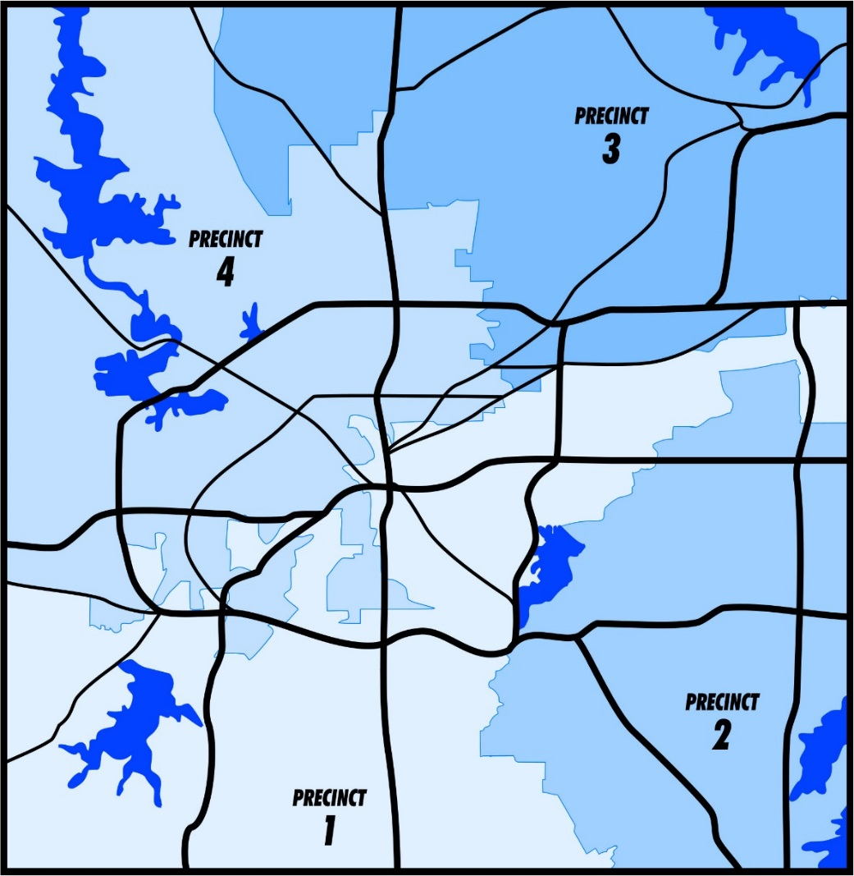
The Citizens Blue Ribbon Committee
Recommendations
Build four new community health centers in the next five to 10 years
Currently have 13 community health centers
Need for primary care facilities will increase as population increases
JPS MAIN CAMPUS
HEALTH CENTERS (PCMH)
20

Slide 21
The Citizens Blue Ribbon Committee
The Citizens Blue Ribbon Committee
Recommendations
Recommendations
Build four new community health centers in the next five to 10 years
Build four new community health centers in the next five to 10 years
Currently have 13 community health centers
Need for primary care facilities will increase as population increases
Health centers close to where clients live addresses some transportation issues
Community health centers allow a greater utilization of preventative care
JPS MAIN CAMPUS
JPS MAIN CAMPUS
PROPOSED HEALTH CENTER LOCATIONS
17
21

Slide 22
The Citizens Blue Ribbon Committee
Recommendations
Construct a behavioral health facility
Current number of psychiatric beds are inadequate and gap will widen in the future
Due to lack of capacity, in 2015, JPS paid private hospitals $3.1 million
Private hospitals not equipped to handle highly complex psychiatric conditions
Behavioral health services spread across campus
A new facility with 298 beds is recommended
22

Slide 23
The Citizens Blue Ribbon Committee
Recommendations
Add an ambulatory surgery center and cancer care center
Day surgery services can move lower acuity surgical cases to a lower cost setting
The current cancer care center is outmoded, too small and has no room for expansion
23

Slide 24
The Citizens Blue Ribbon Committee
Recommendations
Construct a new main tower
Current patient rooms do not meet contemporary industry and best practice standards
Existing mechanical, electrical and plumbing systems are significantly beyond useful life
Current number of beds for <250 FPL population are inadequate
Need for additional beds will increase due to population increases
New main hospital tower will need 676 beds
24

Slide 25
Questions?
25

