Slide 1

Tarrant County Long Range Planning and Analysis for JPS Health Network
Draft Report Review
Stakeholder Engagement
Community Health Needs Assessment
Public Health Department Collaboration
Citizens Blue Ribbon Committee
March 7, 2017

Slide 2
BRIEFING REPORT AGENDA
HMA Project Scope of Work and Approach
Voices of the Community-Stakeholder Engagement
  Stakeholder Interviews
  Focus Groups
  Community Forums
Community Health Needs Assessment
Public Health Collaboration
Future Draft Report Reviews- Select Chapters

Slide 3

PROJECT OVERVIEW
Tarrant County, with the assistance of JPS Health Network, is looking into the future to anticipate changes in population demographics/ growth, technology and how we provide health care services.
With this information, the Tarrant County Commissioners Court will be able to make informed decisions to improve the health status of the County.

Slide 4
PROJECT UPDATE AND BRIEFING
HMA is fully engaged on the project and is receiving excellent support from the Tarrant County and JPS Health Network leadership and staff
Monthly in-person update presentation to the Court on the 4th Tuesday
JPS Board of Managers Planning Committee November 3, 2016
Weekly conference call with County and JPS liaisons
Bi-weekly Dashboard and Written Report
Project is on time and no completion risks identified

Slide 5
Scope of work
Local, Regional, and National Market Analysis
Provide a current and prospective market analysis of health care in Tarrant County, including national macro trends in health care delivery systems with significant behavioral health and academic medical center considerations over the long term, defined as ten to 30 years
JPS’ Role
In the context of the local, regional, and national market analysis, provide an analysis of the current and prospective contribution of JPS Health Network including strengths, weaknesses, opportunities, and threats (SWOT analysis)

Slide 6
Scope of work
Stakeholder Engagement
In collaboration with Tarrant County and JPS, solicit input from the community on perceived health care needs and the impact of any changes in services currently provided by JPS
Evaluation and Report
Review prior planning and analysis completed by JPS and reconcile the appropriateness and reasonableness of the JPS proposal to Market Analysis and Stakeholder Engagement findings; provide information and guidance to Cumming’s Long Range Facilities Planning work; and prepare and present a draft and final report to the Citizens Blue Ribbon Committee, the Tarrant County Commissioners Court, and the JPS Board of Managers

Slide 7
approach
HMA conducted research, engaged stakeholders, developed findings, and provided recommendations for action organized in seven focus areas that form this report’s chapters:
  Voices of the Community: Stakeholder Engagement Process
  Macro Trends in United States Health Care Delivery
  Community Health Needs Assessment
  System Capacity and Population Needs
  JPS Delivery System
  Tarrant County Public Health: Role and Relationship with JPS Health Network
  Market Assessment – Financial Perspectives

Slide 8
Proposed next chapters for review
System Capacity and Population Needs
JPS Delivery System
  Primary Care
  Specialty Care
  Behavioral Health
Financial Perspectives

Slide 9
COMMUNITY ENGAGEMENT - COMMUNITY VOICES
One of our early and most important activities was to listen to Tarrant County community voices regarding the health needs of the county and how JPS Health Network should meet those needs into the future
The engagement work had three components
  Focus Group Meetings
  Community Forums
  Individual Interviews

Slide 10
FOCUS GROUPS - Process
The purpose of the focus groups was to identify:
  Community experience with and perception of JPS; and
  Community health needs and opportunities for JPS and others to meet these needs now and in the future
Two focus groups were held November 3, 2016 at the County Administration Building
Focus groups included:
  Community health advocates including JPS Joint Council members
  JPS users, including JPS Family Advisory Council members
A total of twenty (20) community health advocates and JPS patients were engaged
Word for word transcripts were prepared; a summary analysis of themes was developed

Slide 11
Focus group - Themes
The following themes emerged from the conversations and are presented in no particular order:
JPS improvements are recognized and appreciated by the community.
Interest in having JPS focus more on prevention and social determinants of health with particular emphasis on food security, food policy, availability of healthy food options.
Service expansion and creativity in service delivery is required to meet current and future needs.

Slide 12
Focus group - themes continued
JPS services should be more systematically promoted in the community
There is room to improve patient experience, particularly around access – call center, wait times, call backs
Community partnerships are required to overcome challenges in meeting needs of a diverse population
Behavioral health service and support needs are a priority
More attention should be paid to caregiver support, particularly as the population ages
Concern about polypharmacy (multiple prescriptions), overmedicating seniors and the cost of medications

Slide 13
COMMUNITY FORUMS - AGENDA
The purpose of the community forums was to:
  Introduce the initiative “Tarrant County Long Range Planning Related to JPS Health Network” and share early findings
  Obtain and document community input related to Tarrant County health, health care, and related needs and the current and future role of the JPS Health Network in the broader delivery system
  Inform the public of the website to obtain further information on the initiative, track progress and deliverables, and ask questions

Slide 14
COMMUNITY FORUMS - PROCESS
One forum in each precinct posted by the Commissioners Court
A total of 158 community members participated
Evening meetings were about 90 minutes; language translation was available for American Sign Language (ASL), Spanish, and Vietnamese
Four forums completed as of January 10, 2017; videos posted on the County’s web site were analyzed and themes summarized

Slide 15
COMMUNITY FORUMS – THEMES to Date
Several themes emerged from the forums with the strongest listed below, presented in order starting with highest concurrence among participants:
Strong perceived need to expand inpatient and outpatient behavioral health capacity, now and in the future. Several stressed early intervention, calling out child, adolescent and young adult services
Concern regarding lack of transportation options and the difficulty this poses for accessing JPS downtown location
Perceived need for additional clinics to improve local access. Some indicated clinics are well placed but at capacity, others identified needs in new locations
Perspectives from some speakers were that JPS should focus on “the needy” population; unable to afford care elsewhere

Slide 16
STAKEHOLDER INTERVIEWS
Commissioners Court, County Administrative Leadership, JPS Leadership identified individuals to be interviewed.
  Total Number of Completed Interviews: 107
  Confidential Interview Findings Guide Final Report

Slide 17
Community Health Needs Assessment – Health Status Summary
Based on self-report, access to affordable primary care and dental care for low income persons appears to be difficult
Infant Mortality in particular zip codes and late entry into prenatal care are of significant concern, as is the high rate of sexually transmitted infection
Behavioral health –major depressive episodes are almost twice as high as the national average, and while substance use (for the MSA) is lower than the national average, it has a significant impact on the community
Adult obesity, diabetes, high blood pressure and cancer are some of the key health concerns for the County
Childhood immunization rates and obesity are also in need of attention
Linguistic isolation and transportation barriers make it more challenging to navigate and access health care

Slide 18
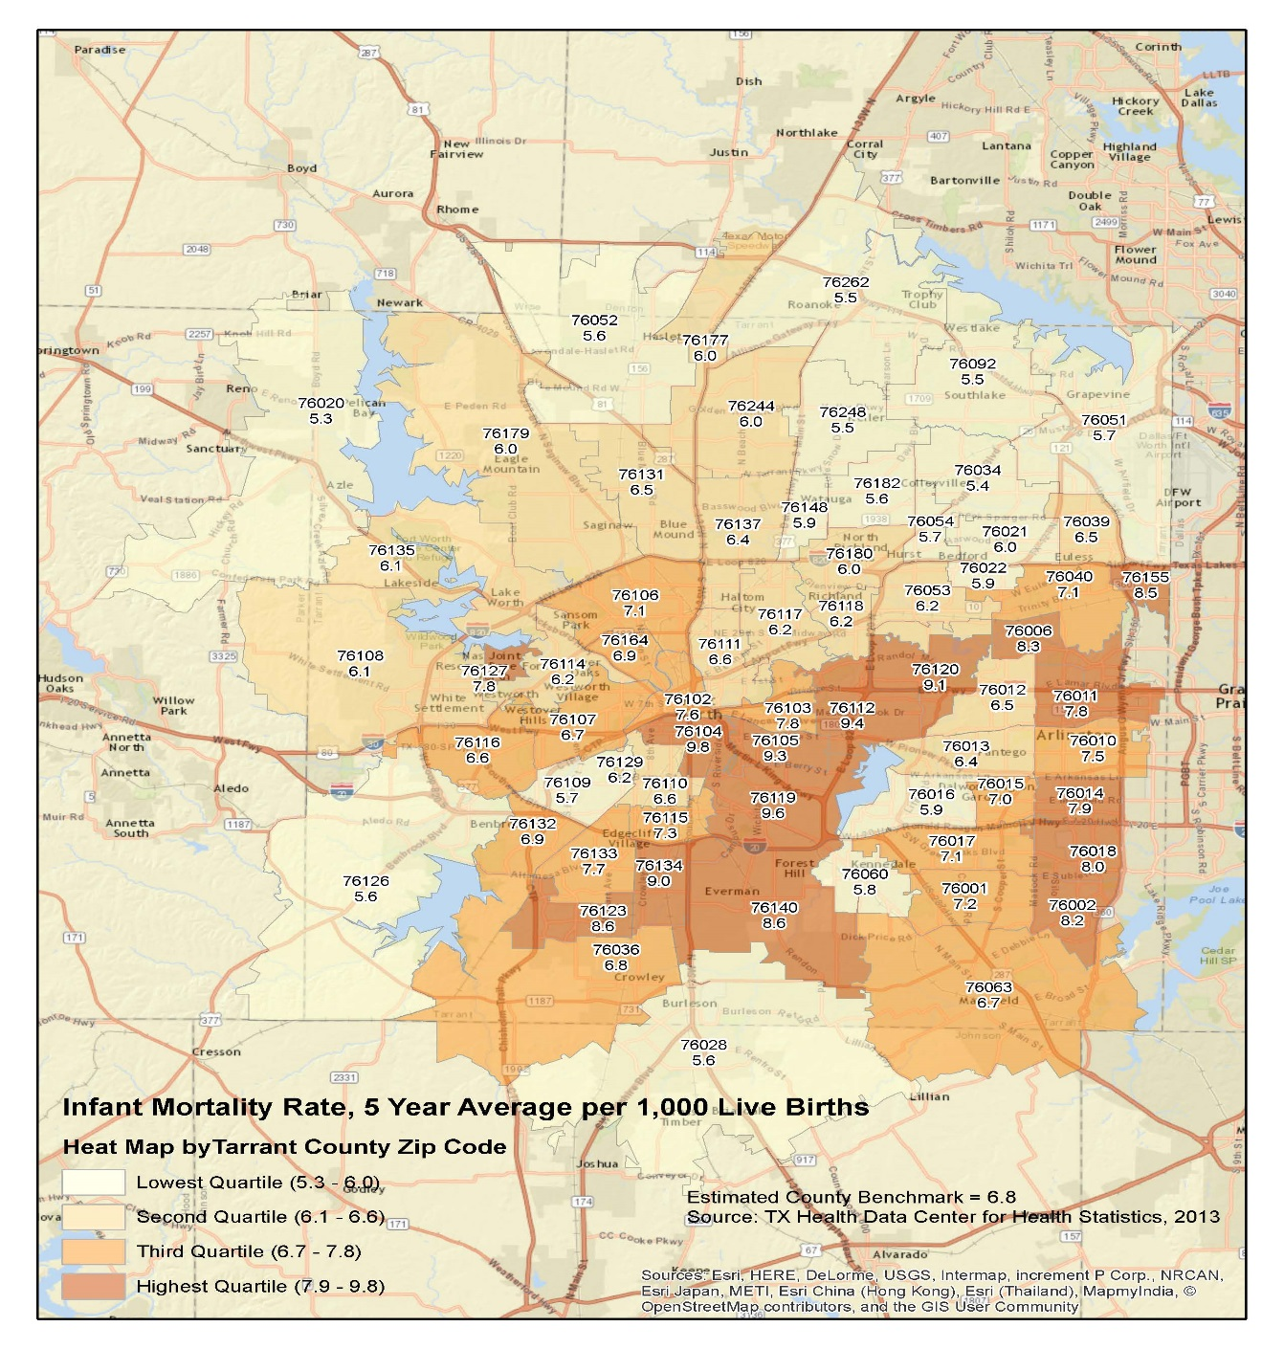
Infant mortality heat map

Slide 19
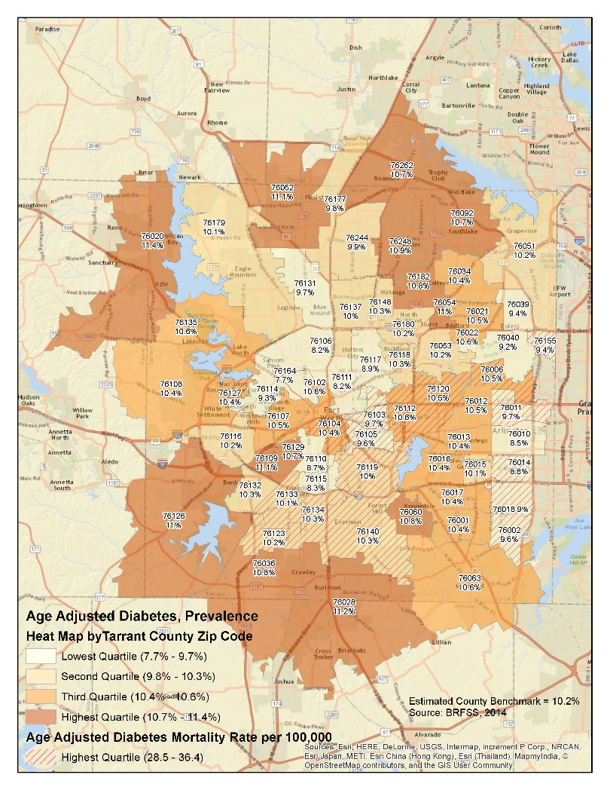
Adult diabetes prevalence heat Map

Slide 20
Population projections
Over the next several decades, the Texas population will be characterized by:
  growth,
  diversity, and
  aging
Hoque, et. al. Projections of the Population of Texas and Counties, 2010-2050. U. of Houston, Hobby Center for Public Policy.

Slide 21
Population projections in next 20 years
In Tarrant County, we expect a 46% increase in population in the next 20 years
The total population will grow from approximately 2M in 2017 to 2.9M in 2037
Assuming population proportions at Federal Poverty Levels (FPLs) remain the same, in 20 years:
  over 1.2 M residents will be <250% FPL
  over 1.8M residents will be <400% FPL
 | 2017 | 2037
Total Population <250% FPL | 857,506 | 1,251,364
Percent of Population <250% FPL | 42.4% | Projections assumed same %
2016 Income cut-off <250% FPL | $60,750 for family of four | NA
Total Population <400% FPL | 1,274,696 | 1,860,173
Percent of Population <400% FPL | 63.1% | Projections assumed same %
2016 Income cut-off <400% FPL | $97,200 for family of four | NA

Slide 22
Population projections For JPS Connection Eligibility
The JPS Connection program provides affordable access to doctor appointments, specialized care and prescriptions for Tarrant County residents who qualify and apply.
JPS Connection eligible population is:
  18 years and older
  Non-Medicaid
  <250% Federal Poverty Level
  Tarrant County Resident
As a payer of last resort, the program includes:
• JPS Connection: Provides assistance to patients without health insurance.
• JPS Connection Homeless Program: Provides assistance to patients without health insurance who are experiencing homelessness.
• JPS Connection Supplemental to Medicare: Provides assistance to patients with Medicare Part A&B or a Medicare Plan contracted with JPS Health Network.
• JPS Connection Supplemental to Insurance: Provides assistance to patients with a primary insurance plan that is contracted with JPS Health Network.

Slide 23
Population projections For JPS Connection Eligibility
We expect the JPS Connection eligible population is currently 425,000 or approximately 49% of the Total Population <250% FPL
We expect the JPS Connection eligible population to grow from approximately 425,000 in 2017 to 621,000 in 2037

Slide 24
Increasing diversity of the population
A key indicator of percent change in race/ethnicity in the coming decades is the % change based on the last two census surveys: 2000 and 2010
Highest percent change is for Hispanics (69% adding 197,687 persons), Black (45.1% adding 82,952 persons), and White (4.7% adding 41,882 person.) Asians and Other have high % change with growing populations as well
 | 2000 | 2010 | Percent Change
Total Pop | 1,446,219 | 1,800,034 | 24.5%
White, non-Hispanic | 895,253 (61.9%) | 937,135 (51.8%) | 4.7%
Black | 185,253 (12.8%) | 268,205 (14.9%) | 45.1%
Hispanic | 285,290 (19.7%) | 482,977 (26.7%) | 69.3%
Asian | 52,594 (3.6%) | 84,561 (4.7%) | 60.7%
Other | 11,570 (0.8%) | 16,200 (.9%) | 40%

Slide 25
Population projections by Age Groupings
Between 2015 and 2021, we expect the population percent change in the:
  early childhood population (0-5 years) to be 10.5%
  the overall adult population (18+ years) to be 13.54%
  the senior population (65+ years of age) to increase by an exceptional 40.57%

Slide 26
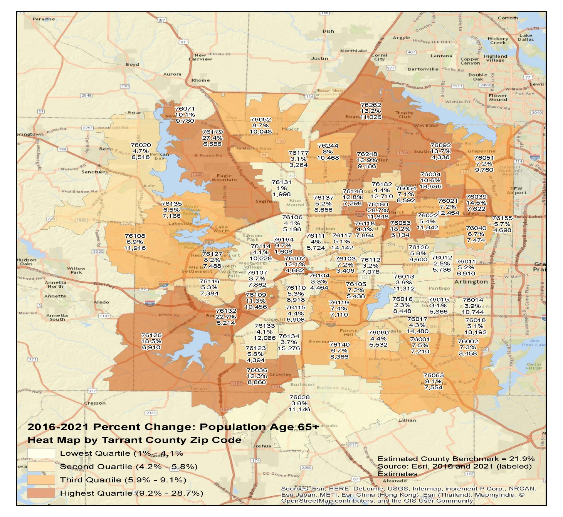
Percent change in Population age 65+

Slide 27
POPULATION GROWTH implications
Tarrant County will likely require substantial additional health care delivery system capacity given population growth
The current safety net health care workforce shortage will need to be addressed to ensure adequate workforce for the population
The County will also need to use approaches that engage increasingly diverse communities and ensure right-sizing of services to meet the long-term service and support needs of the aging population

Slide 28
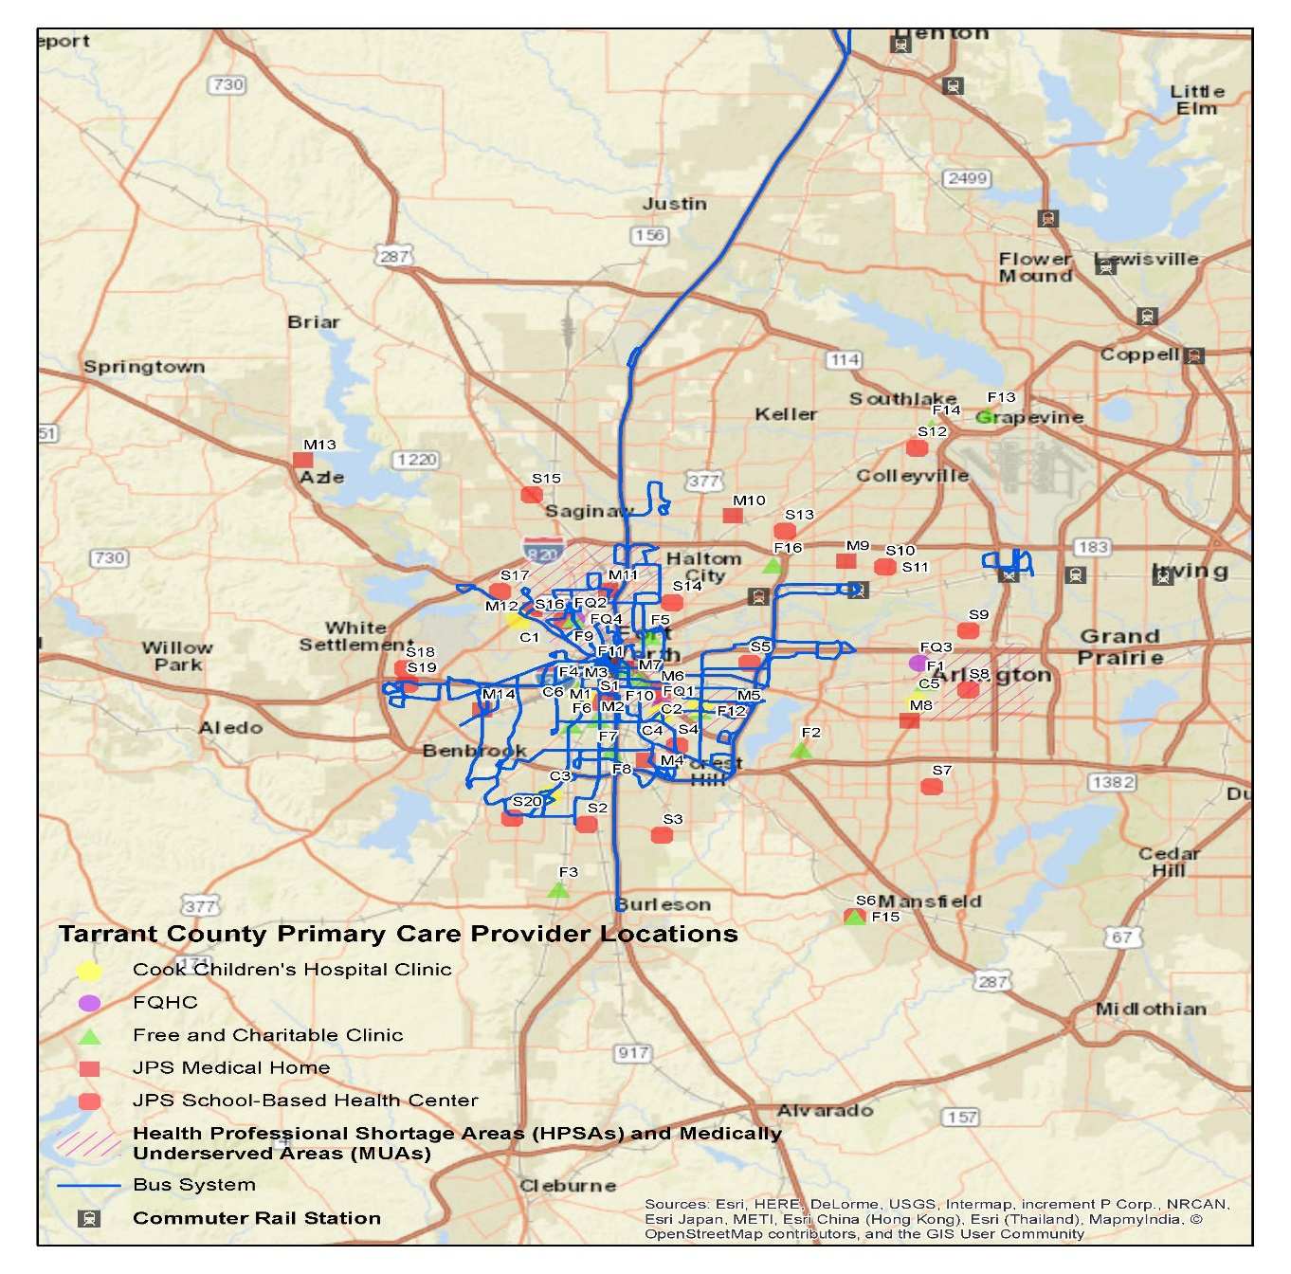
Primary care safety net - insufficient for expected growth

Slide 29
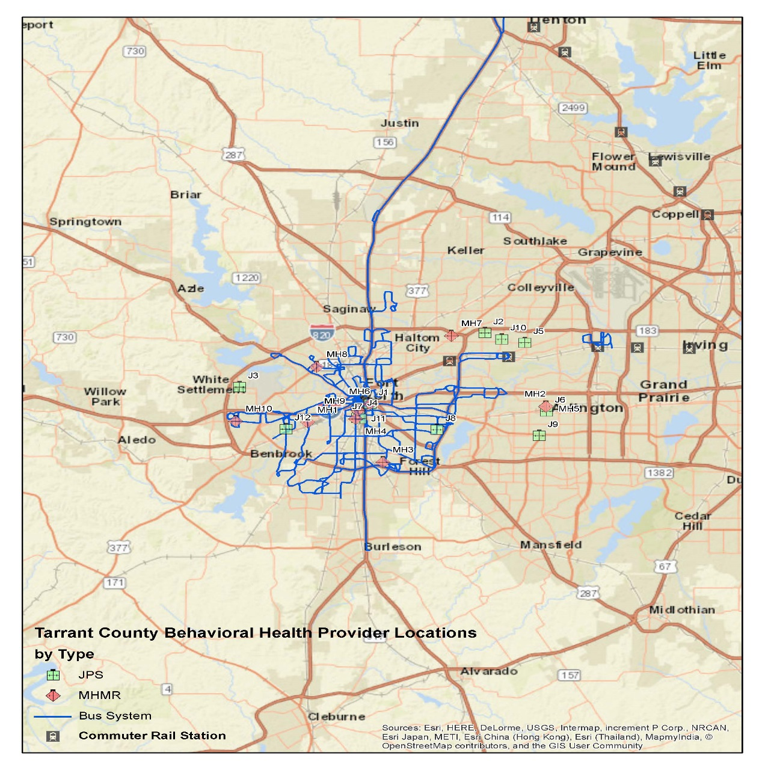
Behavioral health safety net - insufficient for expected growth

Slide 30
CHNA - Key Recommendations
Growth, aging, and increased diversity of the population will have significant implications for the Tarrant County and JPS workforce.
HMA recommends the County and JPS:
1-Determine future population demand for safety net care using national benchmarks and JPS strategic utilization plan criteria to estimate expected county wide shortfall in provider and hospital services
2-Emphasize prevention and management of prevalent and controllable conditions, including diabetes and hypertension, for example. Efforts should include partnerships with public health and community-based organizations
3-Ensure sufficient capacity of services to meet the long-term service and support needs of the aging population
4-Use approaches that engage increasingly diverse communities, such as Community Health Workers recruited from those communities.

Slide 31
Public health collaboration
Tarrant County Public Health (TCPH), a strong local health department with a mission to “safeguarding the community’s health.”
JPS Health Network, a quality health care provider with a mission to “transform health care delivery for the communities we serve.”
While the missions are different, they are complementary and the organizations share the same overall goal of a healthy Tarrant County.

Slide 32
Current collaborations between JPS and TCPH
Current collaborations are focused on:
  reporting notifiable diseases,
  controlling communicable disease such as TB,
  classes to support chronic conditions such as diabetes,
  bi-directional referral for quitting smoking,
  some collaborative work on health policy issues.

Slide 33
Public health collaborations – key Recommendations
HMA recommends TCPH and JPS:
1- Create a Formal Process for Collaboration
2- Work Together to Sustain Priority DSRIP Initiatives
3- Work Together to Support Health Policy Focused on Prevention and Social Determinants of Health

Slide 34
Public health collaborations – key Recommendations
4- Work Together to Mobilize Community Partnerships to Address Particular Health Issues and/or Close Health Service Gaps
5- Expand Evidence-Based Community Programming to Prevent Disease and Injury, and Manage Chronic Conditions
6- Continue to Consider Existing TCPH and JPS Facilities for Potential Service Expansion Sites -- Co-Location and Service Collaboration Where Appropriate

