Slide 1



February 14, 2017

Slide 2

OUR PURPOSE
The future of healthcare
in Tarrant County
The role of JPS in the delivery
of healthcare in Tarrant County
Make recommendations on our
findings and evaluations
2
Notes:
__________________________________________________________
__________________________________________________________
__________________________________________________________
__________________________________________________________
__________________________________________________________

Slide 3
GOVERNANCE
TARRANT COUNTY
MHMR
TARRANT COUNTY
PUBLIC
TCCC appointed
Board of Directors
HEALTH
TARRANT
COUNTY
A department
of Tarrant County
COMMISSIONERS
COURT
TARRANT COUNTY
HOSPITAL
DISTRICT
TCCC appointed
Board of Managers
(JPS)
3
Notes:
__________________________________________________________
__________________________________________________________
__________________________________________________________
__________________________________________________________
__________________________________________________________

Slide 4
AUTHORITY & GOVERNANCE
TARRANT COUNTY
JPS BOARD OF MANAGERS
Create a countywide hospital
District to furnish medical aid
and hospital care to the indigent
Appoint the hospital district
Board of Managers
Approve the annual hospital district
budget and tax rate
Construct, purchase, enlarge,
furnish and equip the county hospital
Employ or manage Executive Director
of the county hospital
Set service rates to produce
sufficient revenue
4
Notes:
__________________________________________________________
__________________________________________________________
__________________________________________________________
__________________________________________________________
__________________________________________________________

Slide 5
Growing healthcare needs of County residents
Prepare for future healthcare needs
Ensure thorough process and citizen involvement
WHY ARE WE HERE?
1985 bond package
JPS accomplishments
  Main Street Campus expansion
  Medical Homes
  School-based clinics
5
Notes:
__________________________________________________________
__________________________________________________________
__________________________________________________________
__________________________________________________________
__________________________________________________________

Slide 6
WHY NOW?
POPULATION TRENDS AND PROJECTIONS
3.5 million
1.8 million
860,000
Estimated growth based on population growth trend from 2000-2010.
Source: University of Houston Hobby Center for Public Policy. (2014). Projections of the Population of Texas
and Counties in Texas by Age, Sex, and Race/Ethnicity from 2010 to 2050. Retrieved from
http://www.uh.edu/class/hcpp/_docs/research/population/2014%20PPRLE-SV2.pdf
6
Notes:
1980 benchmark.
Last JPS bond package was 1985
__________________________________________________________
__________________________________________________________
__________________________________________________________
__________________________________________________________
__________________________________________________________

Slide 7
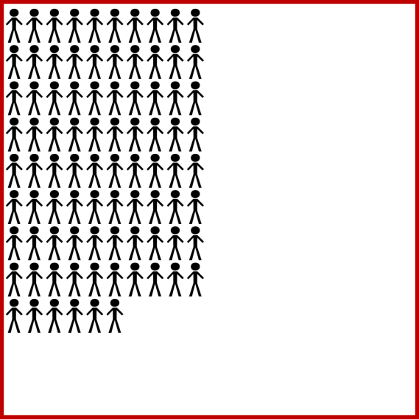
WHY NOW?
POPULATION TRENDS AND PROJECTIONS
1980
860,000
7
Notes:
Each figure represents 10,000 persons
__________________________________________________________
__________________________________________________________
__________________________________________________________
__________________________________________________________
__________________________________________________________

Slide 8
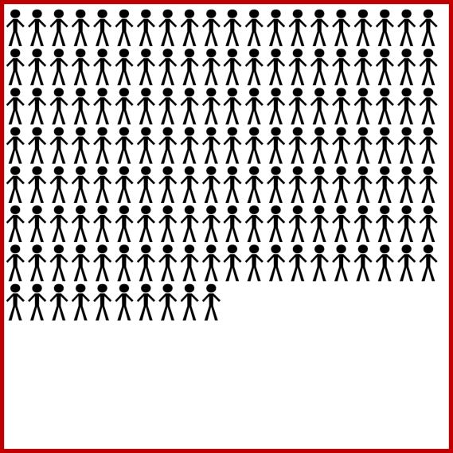
WHY NOW?
POPULATION TRENDS AND PROJECTIONS
2010
1.8 million
8
Notes:
__________________________________________________________
__________________________________________________________
__________________________________________________________
__________________________________________________________
__________________________________________________________

Slide 9
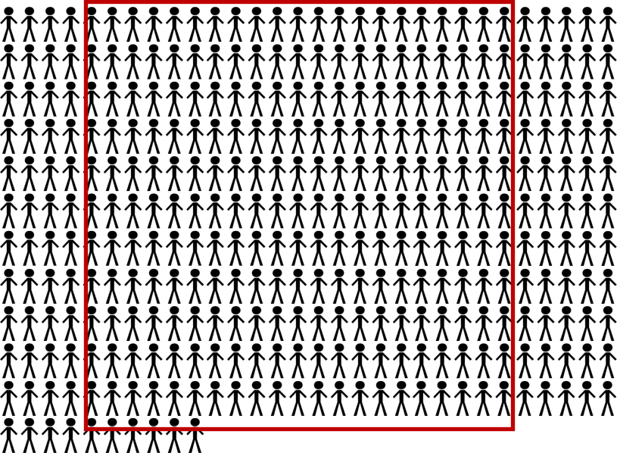
WHY NOW?
POPULATION TRENDS AND PROJECTIONS
2050
3.5 million
(estimated)
9
Notes:
Tarrant County population projected to grow faster and be larger than Dallas County
__________________________________________________________
__________________________________________________________
__________________________________________________________
__________________________________________________________
__________________________________________________________

Slide 10

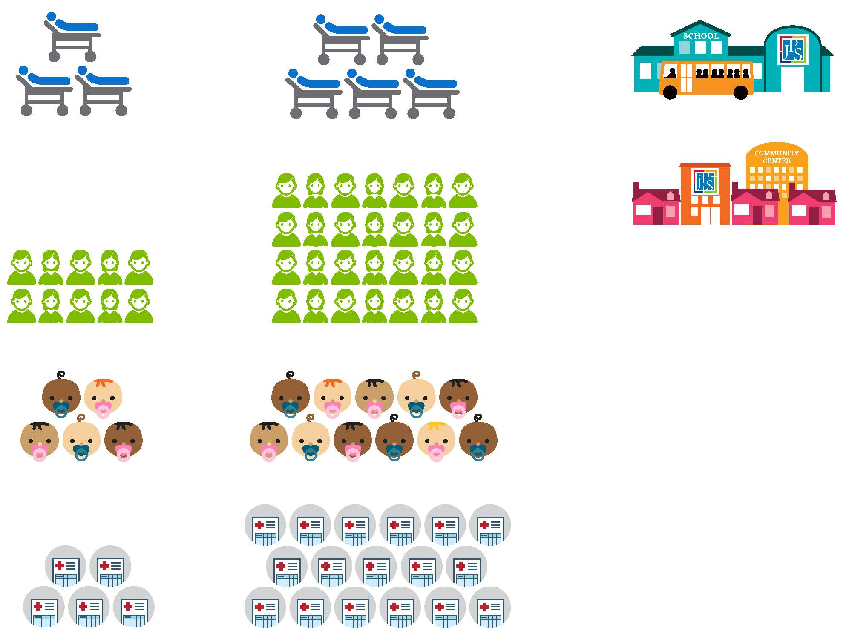

WHY NOW?
JPS SERVICES - TRENDS
Inpatient Beds
Outpatient Visits
Births
63%
746%
Acute and behavioral health licensed beds
1985 – 329 beds
2015 – 537 beds
1985 – 121,871
2015 – 1 million+
1985 – XXX
2015 – XXXX
Patient Days
Emergency Visits
21%
116%
per day
1985 – 116,792
2015 – 141,580
1985 – 65,588
2015 – 141,628
10
Notes:
How these population increases have effected JPS for the past 30 years
(since 1985 bond)
__________________________________________________________
__________________________________________________________
__________________________________________________________
__________________________________________________________
__________________________________________________________

Slide 11
WHY NOW?
FUTURE MEDICAL DEMANDS
Growing and aging population
Diverse population
Advances in medical technology
Advances in healthcare delivery
ACA
Ensure citizen involvement
11
Notes:
19.3% of county residents are without healthcare insurance (U.S. Census Data, 2015)
Diverse populations often have specific medical needs
Future of ACA is uncertain at this time
__________________________________________________________
__________________________________________________________
__________________________________________________________
__________________________________________________________
__________________________________________________________

Slide 12

WHO ARE WE?
6,500 team members
Top 10 employer in Tarrant County
Level 1 Trauma Center
The only one in Tarrant County
Geriatric Trauma Program
The first in Tarrant County
Psychiatric Emergency Center
  The only one in Tarrant County
Correctional Health
60,000+ patient encounters per year
Teaching Hospital
  18 clinical residency and
  fellowship programs
  Over 200 JPS residents
Undergraduate programs
    50 affiliation agreements
    Over 1,000 students
Care for Underserved –
  Nearly 40,000 charity-eligible
  JPS Connection members
12
Notes:
774 physicians Economic Impact – more than 12,500 jobs
132 Behavioral Health beds.
80 adult beds in Trinity Springs Pavilion
16 youth beds in Trinity Springs Pavilion
36 adult beds in Trinity Springs North
Nation’s largest hospital-based family residency
Over 70% of residents are retained to work and live in TC
Residency usually done after internship and graduation
Residency is required training for those with medical degrees under supervision from licensed physicians
A fellowship usually follows a residency. The requirement for a fellowship depends largely on the individual’s field of specialization and the area where he or she wants to practice medicine.
50 affiliation agreements with partners such as TCU, UTA, Texas Wesleyan, Tarlton State, TCC

Slide 13
WHO ARE WE SERVING?
1.7 million
350+
60,000
20,000
5,000
Patient encounters in 2015
Emergency Department visits per day
Urgent care visits per year
Behavioral Health patients per year
Babies delivered annually
13
Notes:
In 2014, there were 25,623 inpatient psychiatric beds nationally.
In 2014, there were 5,425 inpatient psychiatric beds in Texas.
A critical point is that the more you spend on mental health for community based supports, the less beds you need.
The only state that spends less per capital than Texas is Idaho.
As such, we will likely continue to need to larger numbers of beds than the national average because we spend less on community based supports
(national ave = $119.62 per capita, Texas = $40.65)
60-80 BH beds per 100,000 are recommended by the Treatment Advocacy Center. We used 70 as an average.
In Texas the Joint Commission says we have about 10.5 beds per 100,000.
In Tarrant County, we have 514 acute psychiatric beds but only 5 in 100,000 are public hospital beds.
__________________________________________________________
__________________________________________________________
__________________________________________________________
__________________________________________________________
__________________________________________________________

Slide 14
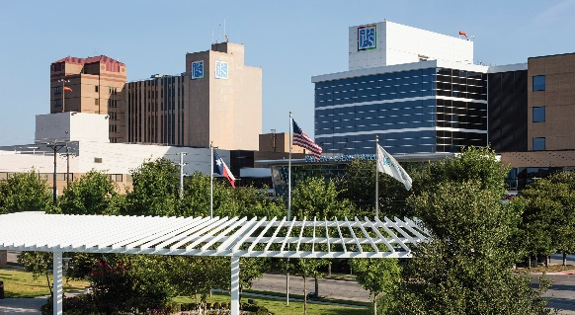
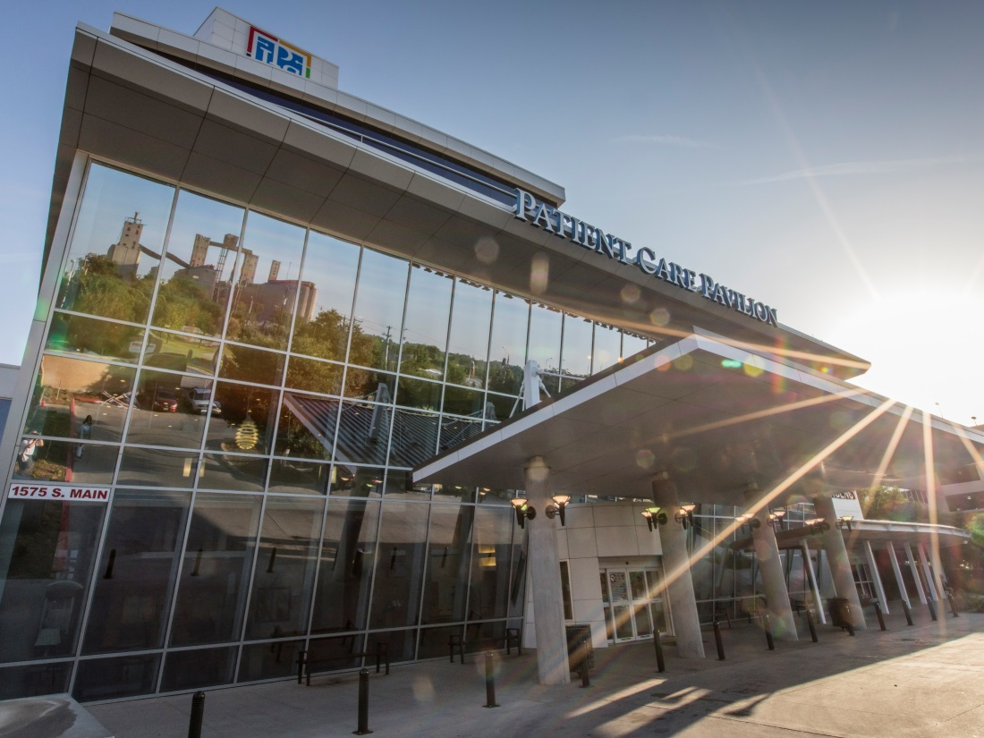
WHERE?
JPS MAIN STREET CAMPUS – FORT WORTH
14
Notes:
__________________________________________________________
__________________________________________________________
__________________________________________________________
__________________________________________________________
__________________________________________________________

Slide 15
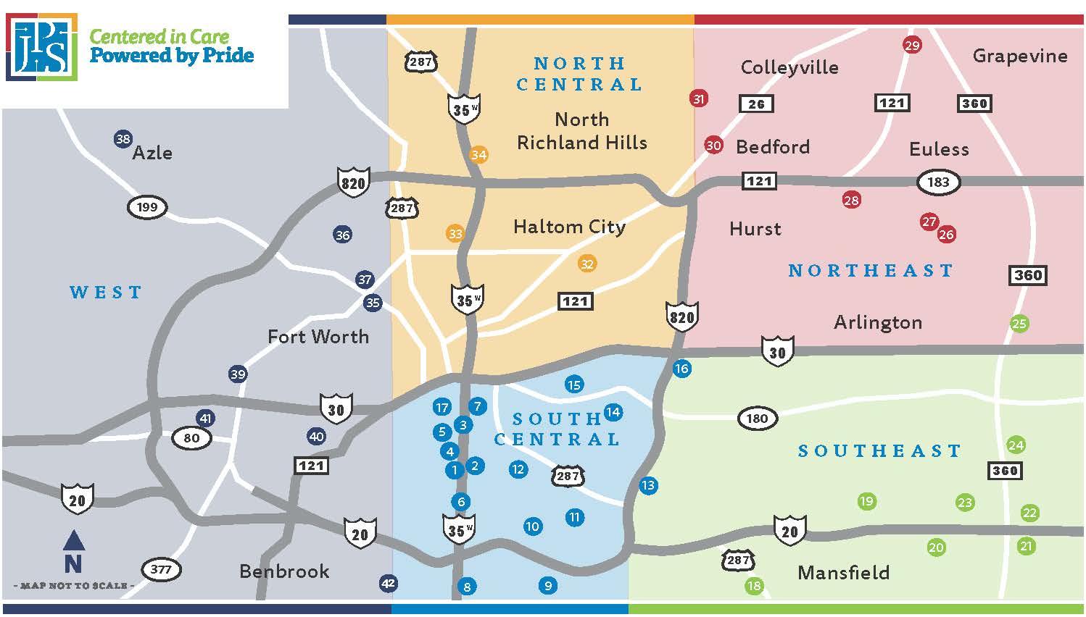
WHERE?
COMMUNITY FOOTPRINT
15
Notes:
JPS Hospital defined sectors.
These do not necessarily reflect Commissioner Precincts
__________________________________________________________
__________________________________________________________
__________________________________________________________
__________________________________________________________
__________________________________________________________

Slide 16
WHERE?
COMMUNITY FOOTPRINT
49 UNIQUE LOCATIONS ACROSS
TARRANT COUNTY, INCLUDING
20 school-based health centers serving 13 school districts
17 primary and pediatric care
2015 – 20
2008 – 11
2006 – 1
2015 – 17
1985 – 2
1978 – 1
16
Notes:
__________________________________________________________
__________________________________________________________
__________________________________________________________
__________________________________________________________
__________________________________________________________

Slide 17
HOW?
OUR OPERATING REVENUE
OTHER REVENUE
5%
DSH, DSRIP, UC
17%
PATIENT SERVICE
REVENUES
39%
AD VALOREM
TAX REVENUE
39%
17
Notes:
39% Ad Valorem Taxes
39% Medicare & Medicaid, commercial insurance plans and patients
17% Supplemental state and federal payments
5% Grants, tobacco revenue, MHMR contracts and other non-patient sources
Total operating budget – approx. $875 million
__________________________________________________________
__________________________________________________________
__________________________________________________________
__________________________________________________________
__________________________________________________________

Slide 18

WHAT IS OUR OBJECTIVE?
Evaluate future health care need
Evaluate health care delivery systems
Hospital district role in this process
Evaluate findings of HMA
Evaluate findings of Cumming
Evaluate findings from various community
Professional and healthcare groups
Make recommendations to
Commissionsers Court for action
18
Notes:
__________________________________________________________
__________________________________________________________
__________________________________________________________
__________________________________________________________
__________________________________________________________

Slide 19
OUR NEXT STEPS
Evaluate HMA Reports: (Mar/April 2017)
  Stakeholder Summary Report
  Community Health Needs Assessment (CHNA)
  Operational Overview
Cumming final Report (May/June 2017)
  Facility Plan
JPS Tour
Make recommendations
  Tarrant County Commissioners Court
  JPS Board of Managers
CBRC to Determine Additional Steps and Timeframe
19
Notes:
__________________________________________________________
__________________________________________________________
__________________________________________________________
__________________________________________________________
__________________________________________________________

Slide 20
February 14, 2017

