Slide 1
Update Report: Tarrant County Commissioners Court
Long Range Planning and Analysis Related to the Tarrant County Hospital District, d/b/a JPS Health Network
October 25, 2016

Slide 2
BRIEFING REPORT AGENDA
Project Updates and Briefings.
Community Engagement—Stakeholder Interviews.
Public Website.
Delivery System Update.
RFP #2—Facilities Plan.
Blue Ribbon Committee.

Slide 3

PROJECT OVERVIEW
Tarrant County, with the assistance of JPS Health Network, is looking into the future to anticipate changes in population demographics/growth, technology and how we provide healthcare services. With this information, the Tarrant County Court Commissioners will be able to make informed decisions to improve the health status of the County.

Slide 4
PROJECT UPDATE AND BRIEFING
HMA is fully engaged on the project and is receiving excellent support from the Tarrant County and JPS Health Network leadership and staff.
Monthly in-person update presentation to the Court on the 4th Tuesday.
JPS Board of Managers Planning Committee November 3, 2016.
Weekly conference call with County and JPS liaisons.
Bi-weekly Dashboard and Written Report.
Project is on time and no completion risks identified.

Slide 5
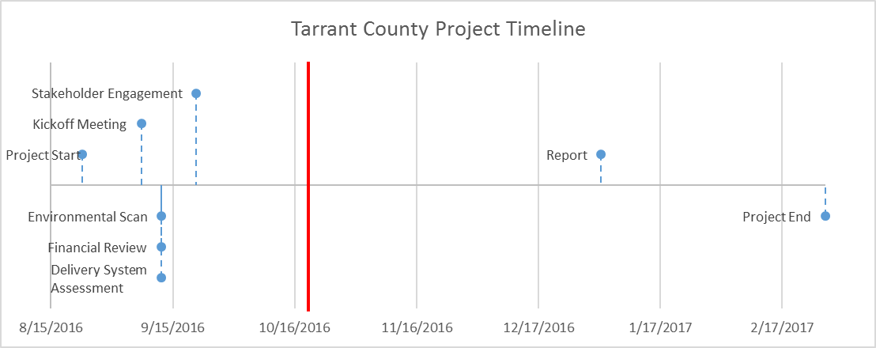
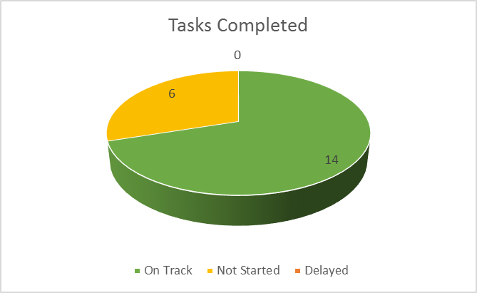
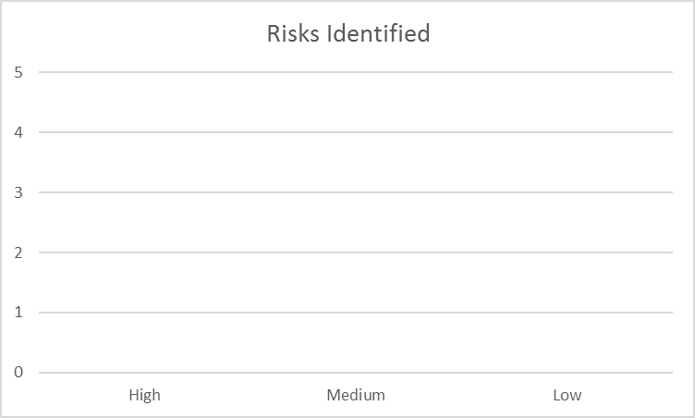
Tarrant County Long Range Planning & Analysis
Project Progress Dashboard - October 21, 2016
Project Status
Accomplished This Month: |  |  | Oct-16
Developed draft plan for community forums and focus groups
RFP #2 specification reviewed/revised by HMA
Community forums & Stakeholder design approved
TCCC 10/25/16 briefing: Presenters, topics, duration approved
Reviewed & analyzed data for NICU and Women’s clinics
Analyzed AHA data comparing JPS to other TX district hospitals
Stakeholder list finalized, letters sent
Upcoming Tasks in: |  |  | Nov-16
Conduct stakeholder interviews & focus group meetings
Perform analysis of charity care needs
Continue financial data analysis
Begin DSRIP review
Continue delivery system analysis
Issue | Action | Assigned To
Stakeholder Meetings | Conduct meetings | L Weiselberg
JPS Board Mtg Planning | Give presentation | W Lyons
Public Website | Develop content | L Weiselberg
Data Collection | Submit data | JPS staff

Slide 6

STAKEHOLDER ENGAGEMENT
Tarrant County Constituents—Community Forums and Focus Groups
Community Leaders
Leaders at other Health Facility and Health Organizations
Elected Officials
JPS Board Members
It is important to address the perceived and actual needs of the community served.

Slide 7
COMMUNITY ENGAGEMENT AND STAKEHOLDER INTERVIEWS
One of our early and most important activities is to listen to the voices of the Tarrant County community regarding the health needs of Tarrant County and how JPS Health Network should meet those needs into the future.
We want to obtain this information before developing or reporting any preliminary findings or recommendations.
Our community engagement work plan includes three components:
  Community Forums
  Focus Group Meetings
  Individual Interviews

Slide 8
COMMUNITY FORUMS
One forum in each precinct through invitation by the appropriate Court Commissioner.
Evening meeting about 90 minutes with refreshments and language translation for Spanish and Vietnamese.
Dates and locations when confirmed will be posted on the Tarrant County web site and other communication methods.
HMA will conduct “listening sessions” to gain input from the general public, including JPS Network users, on health care needs and future direction of the healthcare delivery system in Tarrant County.
We will broadly advertise and conduct four Community Forums—one in each County Precinct—in November and December 2016.
Health Management Associates will summarize themes by Precinct and for the County as a whole.

Slide 9
FORUM AGENDA AND PROCESS
Introduce the initiative “Long-Range Planning and Analysis related to the Tarrant County Hospital District”.
Obtain and document community input related to Tarrant County health, healthcare, and related needs and the current and future role of the JPS Health Network in the broader delivery system.
Inform the public of the website where they can obtain further information on the initiative, track progress and deliverables, and ask questions.

Slide 10
FOCUS GROUPS
Two focus group meetings as small group discussions to include persons who have used JPS Health Network services or who serve on advisory councils.
Facilitated by HMA, the groups will address health care service access in the JPS Health Network, and current and future health care service needs in the County. Focus group participants will include JPS Health Network users and health care advocates from the community.
We will recruit participants and conduct focus groups in November 2016. We will transcribe and analyze the focus group discussions, identify themes as well as individual input. HMA will prepare a report summary for each focus group and an aggregate report of themes across the two focus groups.

Slide 11
INDIVIDUAL STAKEHOLDER INTERVIEWS
Our plan is to interview not less than 90 persons representing a wide range of stakeholder roles and perspectives using a structured set of questions to facilitate a confidential discussion about community health needs, the role of JPS Health Network AND other providers of health and social support services.
Our interview list was developed through consultation with our individual meetings with Tarrant County Court Commissioners, County Judge, JPS Board of Managers and staff.
All members of the Tarrant County Commissioners Court and the JPS Health Network Board of Managers have been interviewed by HMA. JPS executive and medical staff leadership have also met with HMA in group and individual settings. They have provided excellent support to our work.

Slide 12
INDIVIDUAL STAKEHOLDER INTERVIEWS
The external interviews are being scheduled with community leaders in these interest areas:
  Elected Officials.
  Educational Affiliates.
  Health Facilities and Organizations.
  High Volume Hospitals.
  Psychiatric Hospital.
  Skilled Nursing/Rehabilitation/Other.
  Primary Care/Behavioral Health.
  Law Enforcement/Behavioral Health.
  Medicaid Managed Care Organizations.
  Selected Community Groups.
  Philanthropy.
  Business/Civic Organizations.

Slide 13
INTERVIEW LIST
Elected Officials
Interviewee | Organization
Jeff Williams | City of Arlington
Betsy Price | City of Fort Worth
Patricia Ward | Mayor's Council
Jim Griffin | Mayor's Council
Educational Affiliates
Interviewee | Organization
Dean Stuart Flynn | University of North Texas Health Science Center (UNTHSC)
TBD | Texas Christian University (TCU)
TBD | Baylor College of Medicine
TBD | University of Texas Southwestern Medical Center (UTSW)
Troy Moran | Tarrant County College Nursing and Allied Health School
Shawn Tindell | University of Texas at Arlington

Slide 14
INTERVIEW LIST
Law Enforcement/Behavioral Health
Interviewee | Organization
Susan Garnett | MHMR
Cedric Simon | Tarrant County Sheriff's Department
Stephanie Gillespie | Arlington Police Department
Ken Bennett | HEB (Hurst/Euless/Bedford) Police Department
Chief Moore | Hurst Police Department
Chief Brown | Euless Police Department
Chief Gibson | Bedford
Medicaid Managed Care Organizations
Interviewee | Organization
Tisch Scott | Amerigroup
Robert Watkins | Cook Children's Health Plan (CCHP)
TBD | Aetna

Slide 15
INTERVIEW LIST
High Volume Hospitals
Interviewee | Organization
Barclay Berdan | Texas Health Resources (THR)
Janice Whitmire | Baylor All Saints
Erol R. Akdamar | HCA North Texas
Rick Merrill | Cook Children's Medical Center
Psych Hospitals
Interviewee | Organization
Rick Harding | Sundance
Barbara Schmidt | Mesa Springs
Dwight Lacey | Milwood
Rehab/Other
Interviewee | Organization
Jay Grinny | HealthSouth
Matt Malinak | Kindred Hospital Fort Worth
Primary Care/Behavioral Health
Interviewee | Organization
Jeffery L. Milligan | Veteran Affairs North Texas Health Care System
Dr. Liz Trevino | North Texas Area Community Health Centers (FQHC in Tarrant County)

Slide 16
INTERVIEW LIST
Selected Community Groups
Interviewee | Organization
Heather Reynolds | Catholic Charities
Otis Thornton | Tarrant County Homeless Coalition
Father Stephen Jasso | JPS Joint Council/All Saints Catholic Church
Patsy Thomas | Mental Health Connection (MHC)
Philanthropy
Interviewee | Organization
Amanda Stallings | JPS Foundation Board
Pete Geren | Sid Richardson Foundation
Mark L. Johnson | Carter Foundation

Slide 17
INTERVIEW LIST
Businesses/Civic Organizations
Interviewee | Organization
Dee Jennings | Fort Worth Metropolitan Black Chamber of Commerce
John Hernandez | Fort Worth Hispanic Chamber of Commerce
Bill Thornton | Fort Worth Chamber of Commerce
Michael Jacobson | Arlington Chamber of Commerce
W. Stephen Love | Dallas/Fort Worth Hospital Council
Brian Swift | Tarrant County Medical Association
Dr. Susan Simpson Hull | Grant Prairie, ISD
Michael Steinert | Fort Worth, ISD
Aaron Proctor | Salvation Army, Arlington
Tillie Bergen | Mission Arlington
Matt Zavadsky | MedStar

Slide 18
PUBLIC WEBSITE
October 31, 2016 launch.
Provides links to public documents, meeting calendars.
Accepts questions from the public.
Posts Frequently Asked Questions with Answers.
JPS website will link to Tarrant County site.
Spanish & Vietnamese Welcoming Statement with link to further communication support.

Slide 19
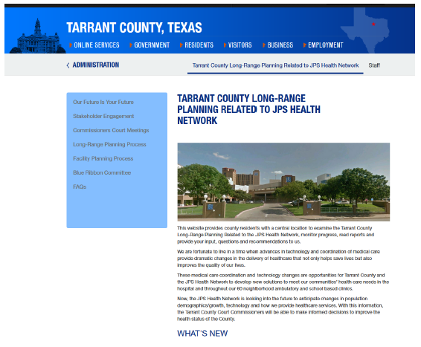
PUBLIC WEBSITE
The public facing website provides a single access point for Tarrant County residents who want to learn more about this process.
Information on the website includes:
Overview of the Project
Community Engagement Initiatives
Tarrant County Commissioners Court Meetings
Long-Range Planning Process
Facility Planning Process
Blue Ribbon Committee

Slide 20
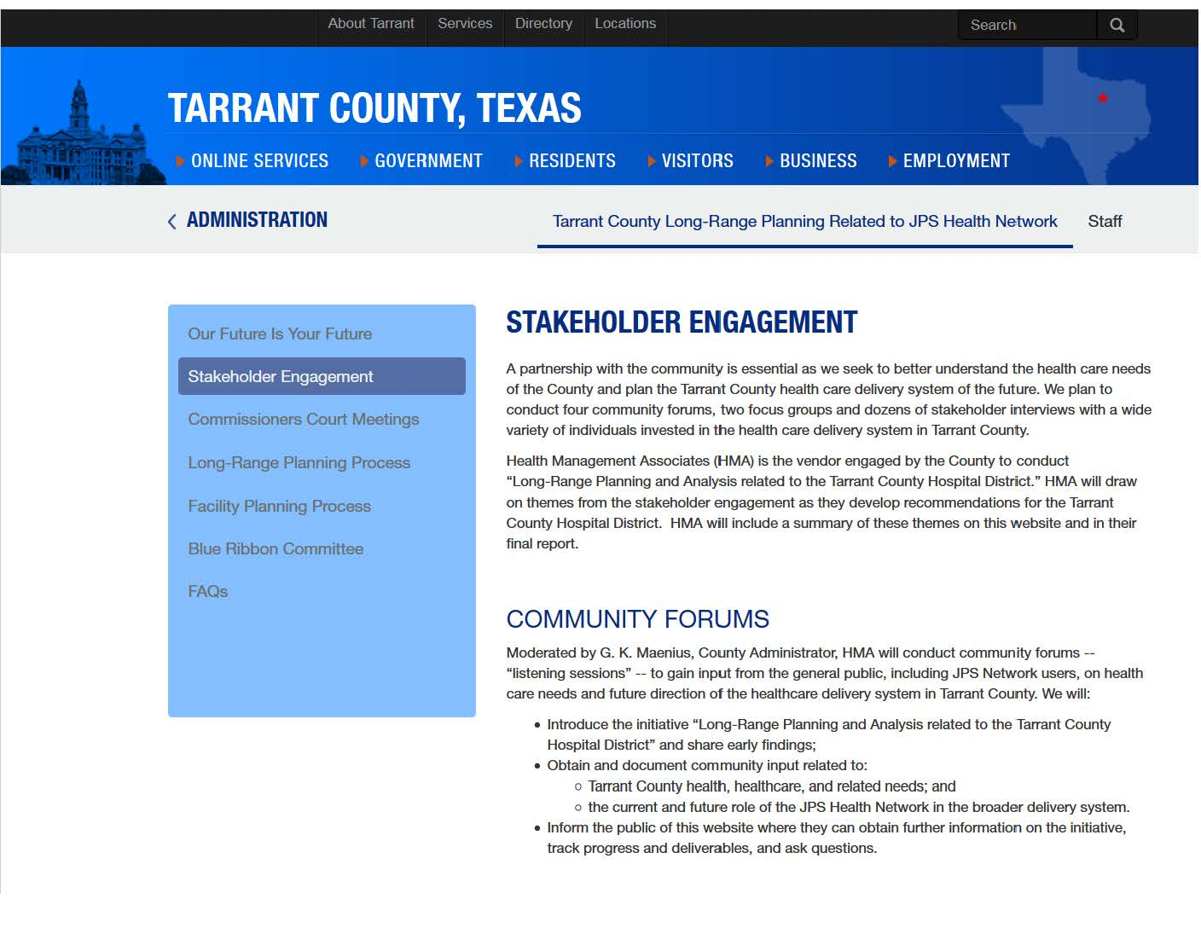
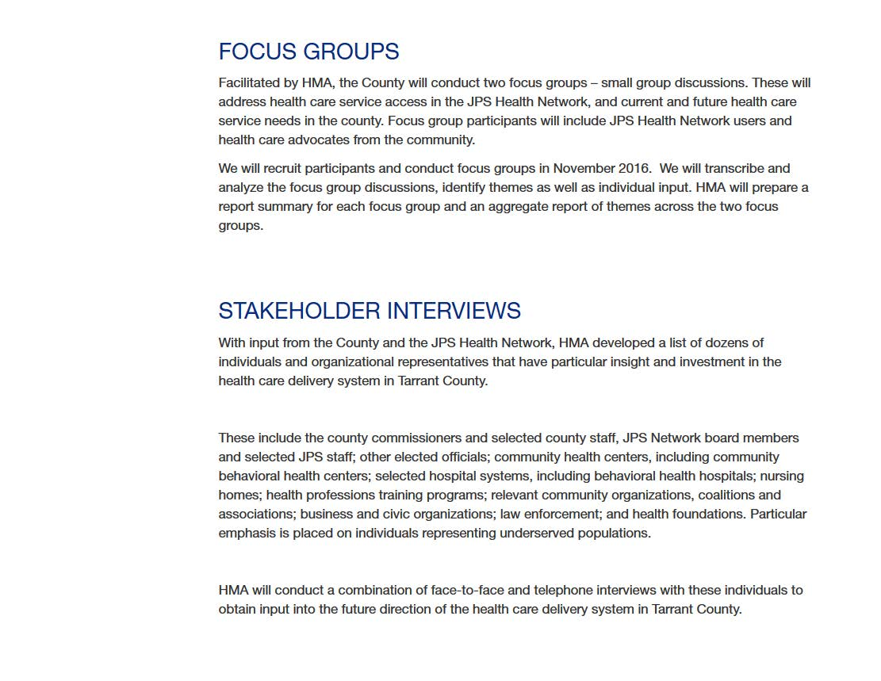
PUBLIC WEBSITE

Slide 21
FACILITIES PLANNING AND ANALYSIS
The court has approved release of RFP NO. 2017-022 for Long Range Planning and Facilities Analysis Related to the Tarrant County Hospital District, d/b/a JPS Health network.
HMA assisted Tarrant County in writing the RFP document and sourcing appropriate vendors.
We will observe the mandatory pre-bid vendor conference and provide observations to Tarrant County leadership.

Slide 22
DELIVERY SYSTEM
Concurrent to the community and stakeholder interviews and focus groups, we are reviewing extensive data provided by Tarrant County and JPS.
HMA subject matter experts will interpret the data and review our findings from the community forums, focus groups and stakeholder interviews.
As we develop initial observations, HMA continuously consults with Tarrant County and JPS leadership to guide development of draft recommendations and interact with the facilities planning consultants.

Slide 23
BLUE RIBBON COMMITTEE
When the Blue Ribbon Committee is appointed, chartered and convened, HMA looks forward to briefing those members who have not already been interviewed by us so that the committee is well prepared for its work.

